Slide 1
As opposed to the 8086 which offered only one operating mode, the 80286 actually incorporated two: A backward compatible 8086 operating mode called Real-Mode and a secondary advanced mode called Protected-Mode
Protected-mode allowed the 80286 to exploit its 24-bit address bus and thus access up to 16MB of physical memory

Slide 2
it was impossible to return gracefully back to real-mode once you switched the processor into protected-mode. The only way for doing so was by resetting the processor - a highly time consuming operation
Although protected-mode gave the processor an ability to access its entire address space, memory access was not linear but had to be done using segments. The maximum size allowed for each segment was 64KB (much the same as on the 8086)

Slide 3
Moving to Protected Mode…
The following steps accomplish the switch from the real mode to the protected mode
Initialize the Interrupt Descriptor Table so it contains valid interrupt gates for at least the first 32 interrupt type numbers; The IDT may contain up to 256 8 – byte interrupt gates defining al 256 interrupt types.

Slide 4
2. Initialize the Global Descriptor Table (GDT) so it contains a null descriptor at descriptor zero, and valid descriptors for at least one code, one stack, and one data segment
3. Switch to protected mode, setting the PE bit in CR₀
4. Perform the Intra-segment (near) JMP to flush the internal instruction queue and load the TR with the base TSS descriptor

Slide 5
5. Load all the data selectors (segment registers) with their initial selector values
6. The 80386 is now operating in the protected mode, using the segment descriptors that are defined in GDT and IDT
The protected system memory map set up is shown in next slide

Slide 6
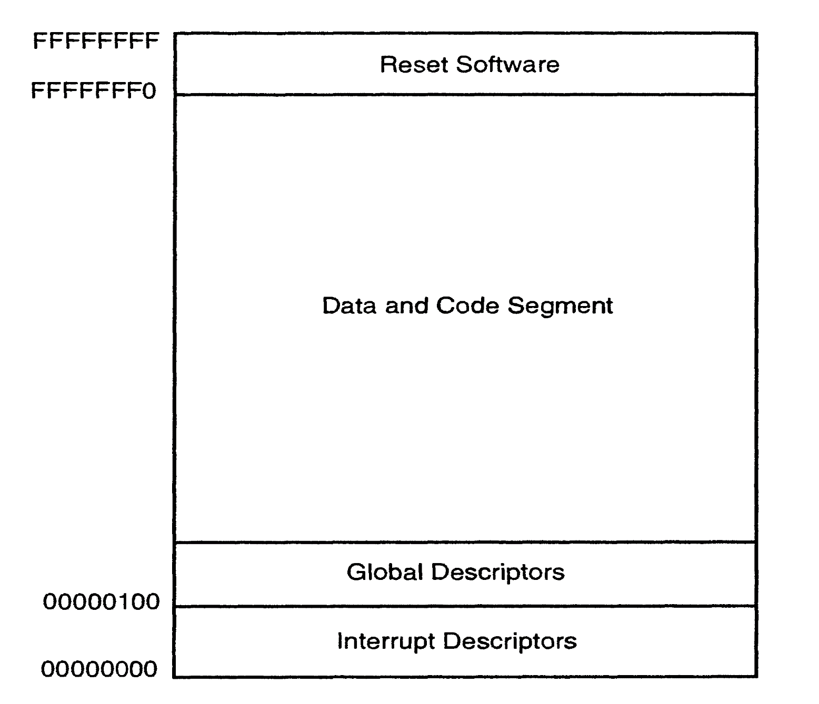

Slide 10
